Slide 1
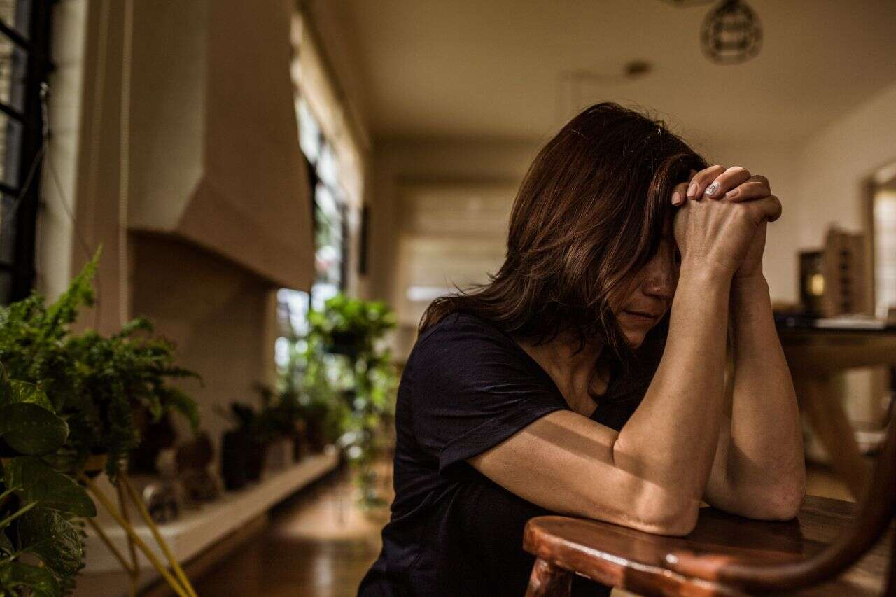


OUR PROGRAMMES
HEAR MY CRY
STUDYING THE WORD
SHALL WE PRAY
The heart cry of a weary soul as described by King David in the Psalms reveals the extent to which men need the intervention and the grace of God to excel on this side of the kingdom. Come and make your desires known to God as we cry with one voice.
The Lord is waiting to fill your mouth with laughter.
Join us every 2nd and 3rd Wednesday of every month, by 10.00am.
If there is one thing you can count on with God, it is that you can never predict when He will change the course of your life and lead you down a path of blessings you couldn’t imagine. That’s why we must approach the Bible as a story - the story of God, and of God's people throughout history. What makes it dynamic and present today is that the story hasn't ended.
Join us as we deepen your knowledge of Christ every Tuesday, 6.30 pm – 8.00 pm.
Prayer isn’t just about asking God for things you need or desire. It’s also about establishing a relationship with Him built on faith and trust in Him. God knows the desires of your heart long before you even think to ask, but he still loves to hear from you—whether you're asking for guidance or giving thanks—because it draws you closer to him.
Join us every Thursday between 6.30 pm – 8.00 pm as we collectively seek God’s face.

Slide 2


PURPOSE Our Home Fellowships provide an opportunity to grow spiritually through Bible study, worship, fellowship, encouragement, and accountability; to develop Christian friendships through interaction, prayer, and activities; and to demonstrate Christian love through instructing, admonishing, and serving one another in the group, and as the opportunity arises, those in our church and our communities.
HOME FELLOWSHIP DETAILS Our Home Fellowships are committed together to: • Praise: In spirit and truth, singing praises to God • Nurture: Bible study, prayer, Scripture memorization • Community: Fellowship spiritually and materially, affirm and encourage, exhort and admonish, testify and share, fellowship with other Home Fellowships, meet individually and as a group outside regular meeting times • Missions: Service projects for the believers and unbelievers, serving with other Home Fellowships HOME FELLOWSHIP MEETINGS:
Our Home Fellowship meetings take place on the 2nd and 4th Sunday of every month.
JOINING A HOME FELLOWSHIP
Everyone is welcome to sign up to join the group of their choice or the closest to their homes. FOR MORE INFORMATION For more information, contact Bro. Michael on 08182806155.
HOME FELLOWSHIP A Home Fellowship is a group of adults (and children) who commit to regularly meeting together for worship, Bible study, prayer, and service in a home and, as needs arise, meeting and serving together in order to equip and disciple members and train new leaders. Our Home Fellowship Ministry exists to glorify God, exalting Him through the teaching of His Word, so that everyone may know Christ and be conformed to His image by the power of the Holy Spirit.

